Slide 1
MAURITIUS
Fisheries Monitoring Centre (FMC)
January 2023

Slide 2
Terminology
FMC – Fisheries Monitoring Centre
VMS – Vessel Monitoring System
MCS – Monitoring, Control and Surveillance

Slide 3
Management tools
New and adaptive tools are needed to monitor and regulate fishing practices through out the world
Traditional MCS tools include onboard observers, air & sea patrol vessels, and targeted inspections
The application of a Vessel Monitoring System (VMS) and the use of satellite technology has become an additional MCS tool to help coastal states manage and conserve their marine resources

Slide 4
Fisheries and Marine Resources (Vessel Monitoring System) Regulations 2022 – GN No. 247 of 2022
The Mauritius FMC which is presently housed at the Albion Fisheries Research Centre is equipped with a satellite-based VMS since 2005
The FMC was set up under Fisheries and Marine Resources (Vessel Monitoring System) Regulations GN 87 of 2005
On 08 September 2022 Fisheries and Marine Resources (Vessel Monitoring System) Regulations GN 247 of 2022 was promulgated
Any offence or contravention of the regulation is liable to a fine not less than EUR 1000 and not more than EUR 1M or its equivalent in MUR.

Slide 5
Function of the FMC
The FMC has as main objective to monitor registered local and foreign fishing vessels that operate in accordance to fishing licence issued by the Ministry
Fishing activities of vessels are monitoring and controlled for better protection and management of the fisheries resources in Mauritian waters as per national regulations and international resolutions

Slide 6
Satellite-based VMS
The VMS monitors the location, speed and direction of licensed fishing vessels by means of various satellite-based tracking systems
The VMS provides a graphical interface that gives users instant access to the positions of all vessels that are reporting
The VMS is also used by the National Coast Guard

Slide 7
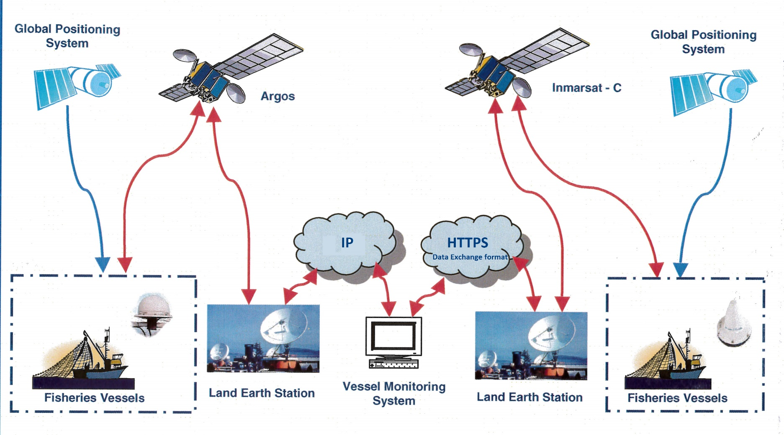
VMS network

Slide 8
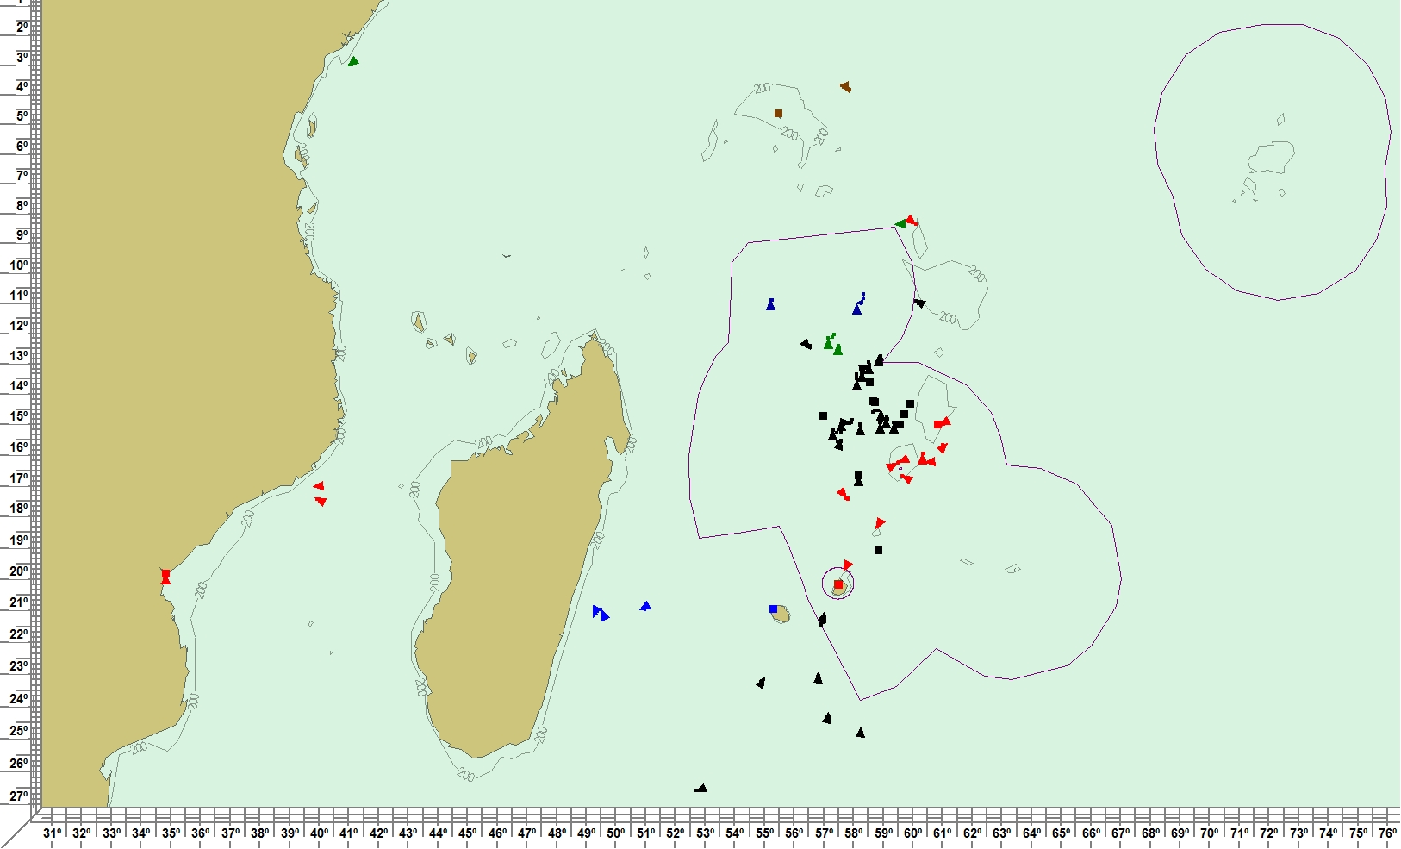
VMS situation on a specific day for all fishing vessels reporting in and out of the Mauritian EEZ

Slide 9
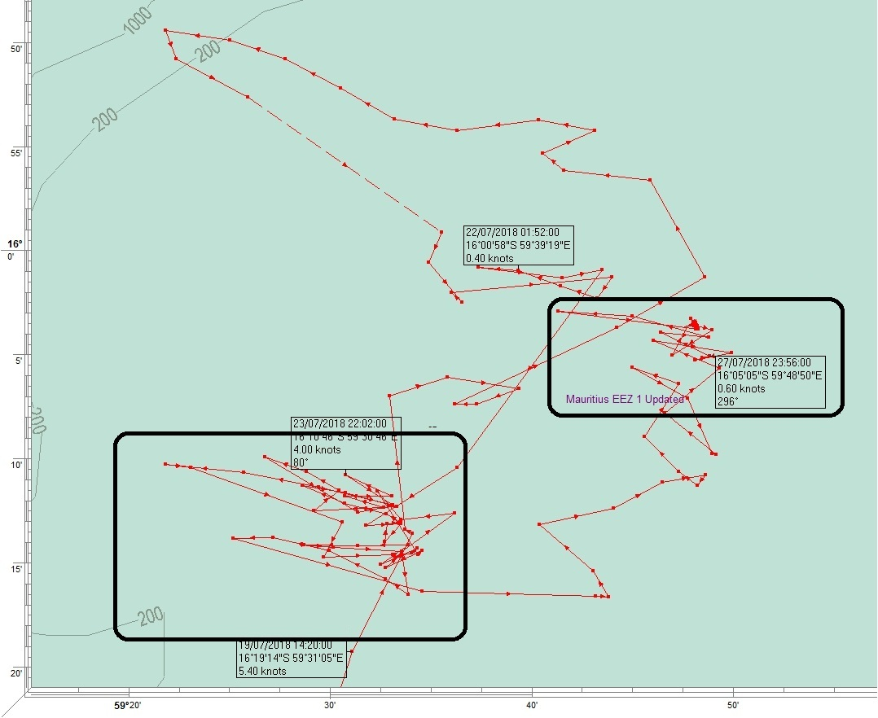
Mapping track of a fishing campaign
Map feature visual representation of fishing behaviour

Slide 10
New tools at the FMC
Monitoring challenges are addressed by implementing additional tools such as Automatic Identification System (AIS) data, Synthetic Aperture Radar (SAR) and Satellite Imagery.
Combination of methods for identifying suspicious behaviour of vessels at sea that may be illegal or contravening fisheries and other regulations and legislations

Slide 11
Thank you for your time and attention

